Slide 1

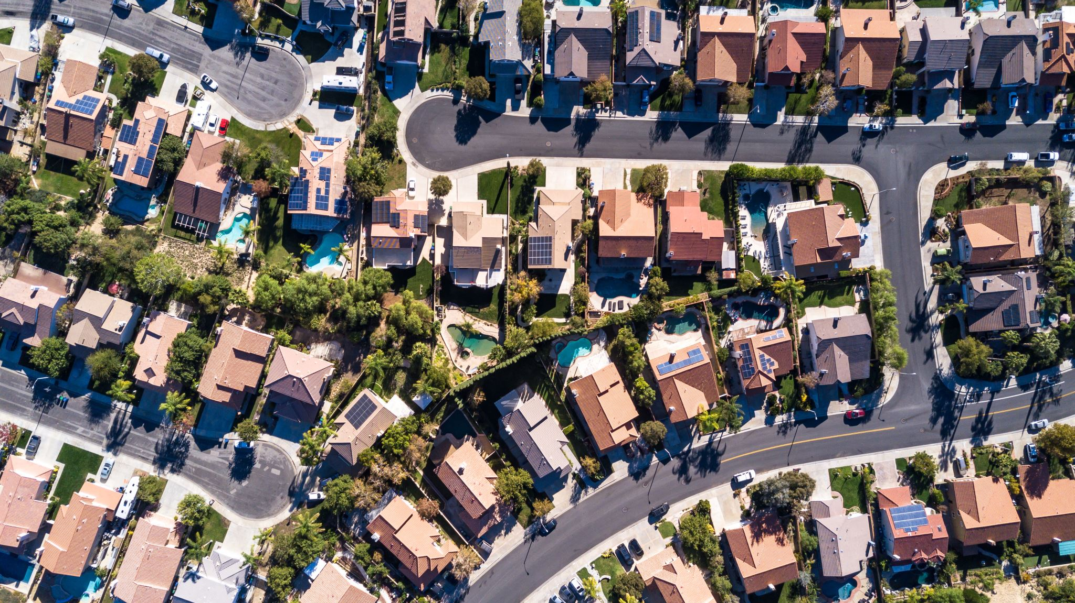
What can it be the price of house in California?
By
Vikas Rayala
Manikanta reddy kallam

Slide 2
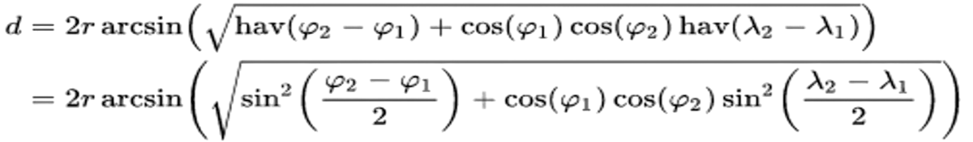
Data Source
The original data was initially featured in the paper: Pace, R. Kelley, and Ronald Barry. "Sparse spatial autoregressions." Statistics & Probability Letters 33.3 (1997): 291-297. They collected information on the variables using all the block groups in California from the 1990 Census.
Data dimensions : 20640 observations x14 variables
Created distance columns from major cities based on Harversine formula with latitudes and longitudes.

Slide 3
Variable description
Response Variable :
Median_House_Value : Median house value for households within a block (measured in US Dollars) [$]
Potential Predictor variables :
Median_Income :Median income for households within a block of houses (measured in tens of thousands of US Dollars) [10k$]
Median_Age : Median age of a house within a block; a lower number is a newer building [years]
Total_Rooms : Total number of rooms within a block
Total_Bedrooms : Total number of bedrooms within a block
Population : Total number of people residing within a block
Households : Total number of households, a group of people residing within a home unit, for a block
Latitude : A measure of how far north a house is; a higher value is farther north [°]
Longitude : A measure of how far west a house is; a higher value is farther west [°]
Distance_to_coast : Distance to the nearest coast point [m]
Distance_to_Los Angeles : Distance to the centre of Los Angeles [m]
Distance_to_San Diego : Distance to the centre of San Diego [m]
Distance_to_SanJose : Distance to the centre of San Jose [m]
Distance_to_SanFrancisco : Distance to the centre of San Francisco [m]

Slide 4
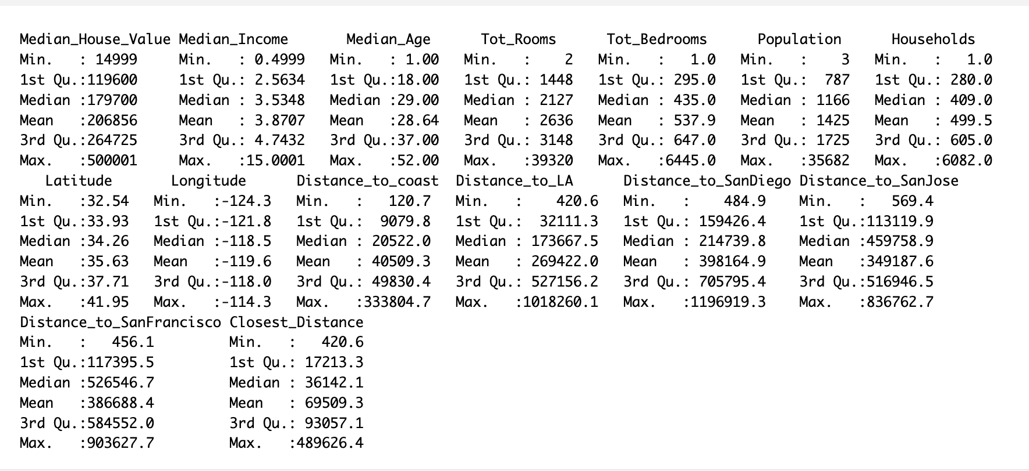
Statistical analysis

Slide 5
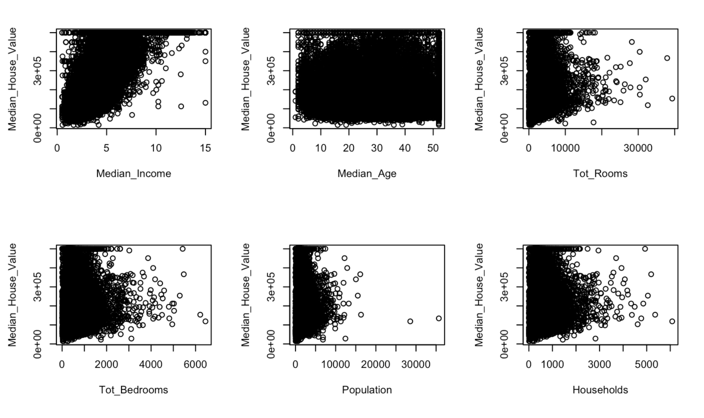
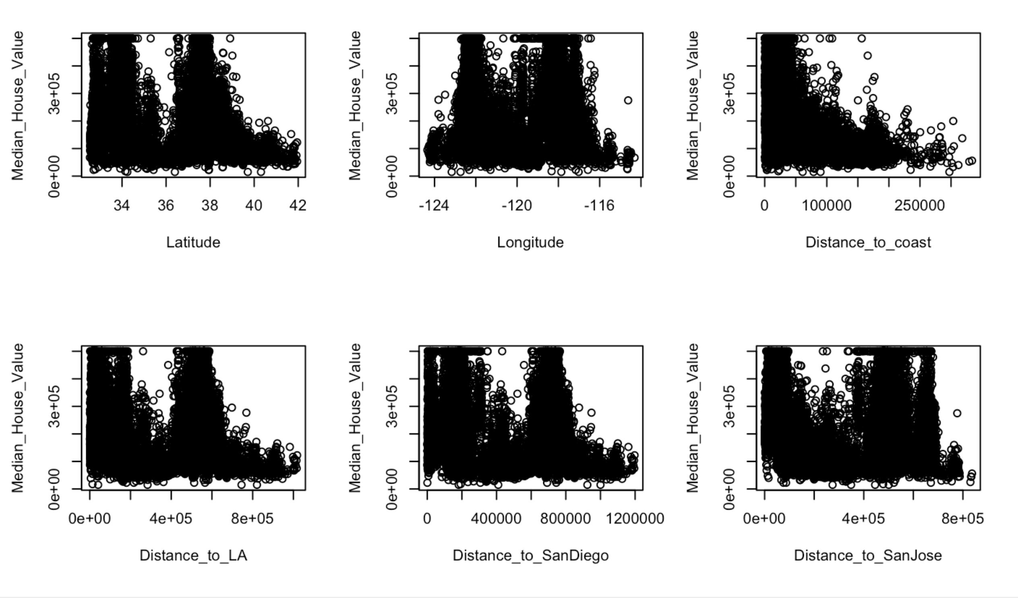
Statistical analysis

Slide 6

Statistical models

Slide 7
Multi linear regression (MLR)
Full/partial additive model
Simple and easy to understand and interpret
Works great for linear data with constant variance
Better accuracy, provided no multicollinearity

Slide 8
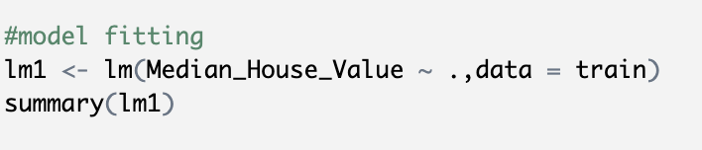
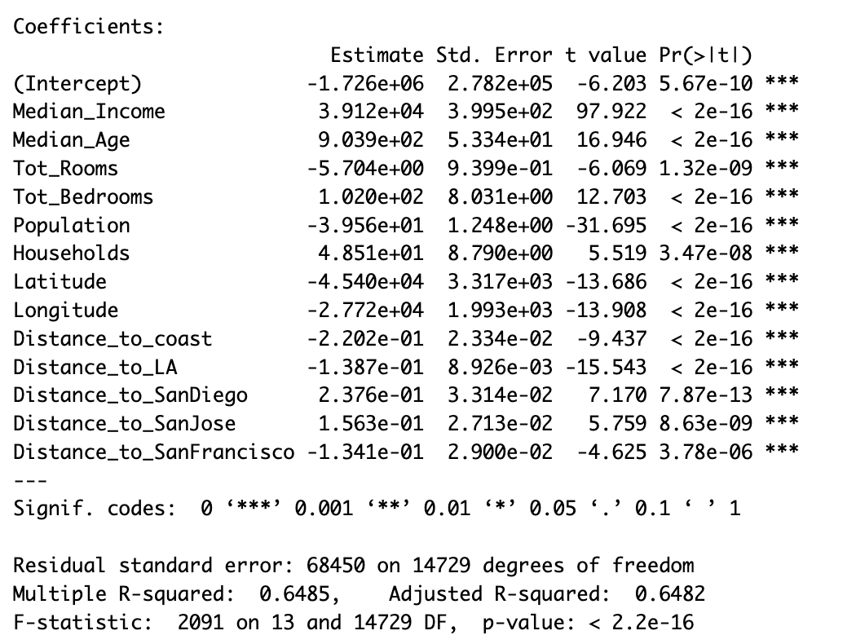
mlr
All the predictors are highly significant.
Although the adjusted r^2 value is 0.62, the model violates the assumptions.

Slide 9

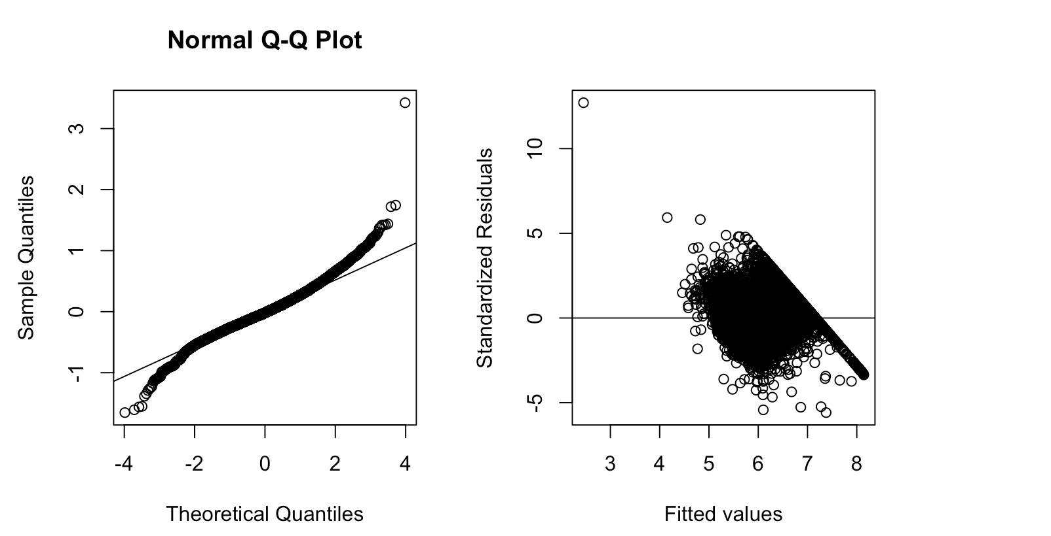
Assumption check and transformation
Transformed model based on boxcox lambda value.
Removed insignificant predictors to enhance performance and remove overfit.

Slide 10

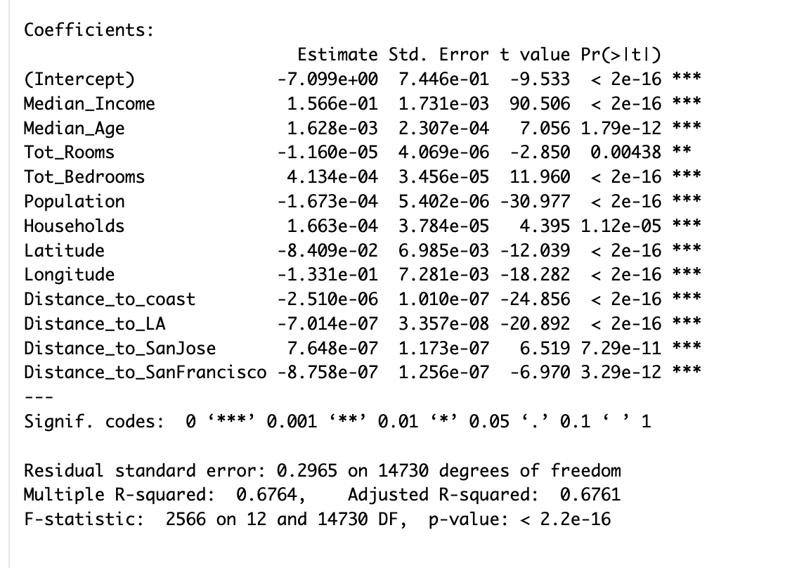
Accuracy and AUC
Upon transformation, adjusted r^2 value got improved but still violated the assumptions.

Slide 11

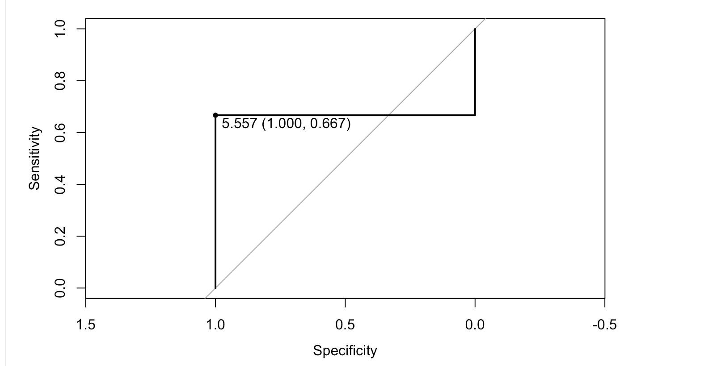
Conclusion
AUC value after response transformation is 0.6667
Since the predictors are highly correlated, we are going ahead and testing another statistical algorithms to fit better for prediction.

Slide 12
Random forest
Random Forest is an ensemble method that combines the predictions of multiple decision trees, which can help to improve the accuracy and reduce the variance of the model.
It can handle both categorical and continuous predictor variables, and can automatically detect and model complex interactions between them.
It is a non-parametric method, meaning that it makes no assumptions about the underlying distribution of the data.

Slide 13
Accuracy
Treshold | Accuracy
10 | 49.40%
20 | 76.24%
30 | 88.60%
Performed with ntrees = 500
Splitted data into 75:25 ratio for training and testing.

Slide 14
XGBoost Model
eXtreme Gradient Boosting which is well known as XGBoost is a widely used model for most of the competitions.
As decision tree & random forest models XGBoost is also a tree based model with more accurate results.
With customized objective and evaluation XGBoost is easy to perform with a inbuild keyword xgboost.
XGBoost does not perform so well on unstructured data & this method is hardly scalable.

Slide 15
Model and results
Built a model with training data & response variable (median_House_Value).
It was built with 100 boosting rounds.
Accuracy noted from the model is 85.27%

Slide 16

KNN - Model
K-Nearest Neighbors or well knows as KNN - Model.
The k value in the k-NN algorithm defines how many neighbors will be checked to determine the classification of a specific query point.
Easy to implement and adapts easily
Doesn’t scale well and issue with dimensionality.

Slide 17
KNN – Model and accuracy
Tried building model with different k values froms 1-6.
Observed that k-6 has best results when compared to others.
Observed an accuracy of ~72 with k is 6.

Slide 18
Results and Discussions
After studying all the models, we observed that XGBoost has the best accuracy among others, but if we consider the Random forest with 30% threshold it gives us best output.
In the sought of unbaised results we choosed Xgboost.

Slide 19
Limitations
Due to huge chunk of old data, we noticed many extreme outliers in the means of total rooms and no of bedrooms.
As shapiro test is limited to 5000 observations cannot perform normality test.

Slide 20

Future Scope
As going further, we would like to check what best can be done to improve the results by fixing the data.
Project will be uploaded to github and sample codes will be provided for other models.

Slide 21


Any Questions?

